Slide 1

Chapter 15 Part 2
Database Connectivity and Web Technologies
The slides in this presentation have been adapted from slides provided with the textbook, Database Systems: Design, Implementation, and Management,
12E, Cornel and Morris, Copyright © 2017 Cengage Learning.

Slide 2
Learning Objectives
How Web-to-database middleware is used to integrate databases with the Internet
What services are provided by Web application servers
Copyright © 2017 Cengage Learning
2

Slide 3
Java Database Connectivity (JDBC)
Java: Object-oriented programming language that runs on top of web browser software
Application programming interface that allows a Java program to interact with a wide range of data sources
Copyright © 2017 Cengage Learning
3

Slide 4
Advantages of JDBC
Company can leverage existing technology and personnel training
Allows direct access to database server or access via database middleware
Allows programmers to use their SQL skills to manipulate the data in the company's databases
Provides a way to connect to databases through an ODBC driver
Copyright © 2017 Cengage Learning
4

Slide 5
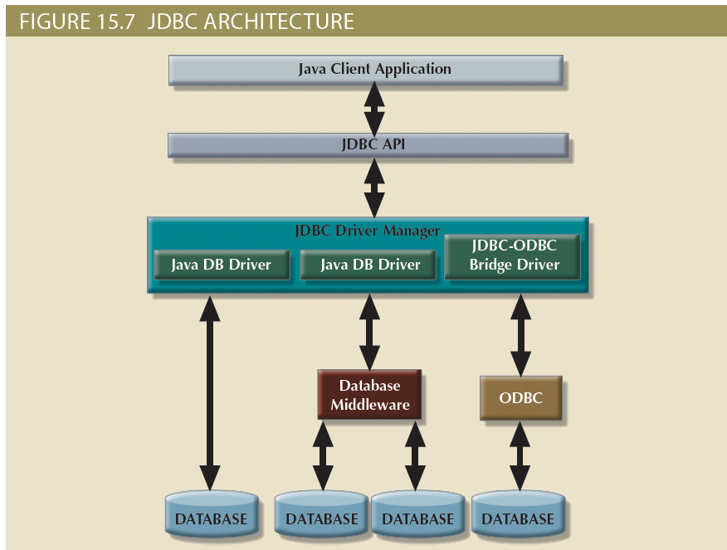
Copyright © 2017 Cengage Learning
5

Slide 6
Web-to-Database Middleware
Web server is the main hub through which Internet services are accessed
Server-side extension: Program that interacts directly with the web server
Known as web-to-database middleware
Provides its services to the web server in a way that is totally transparent to the client browser
Middleware must be well integrated
Copyright © 2017 Cengage Learning
6

Slide 7
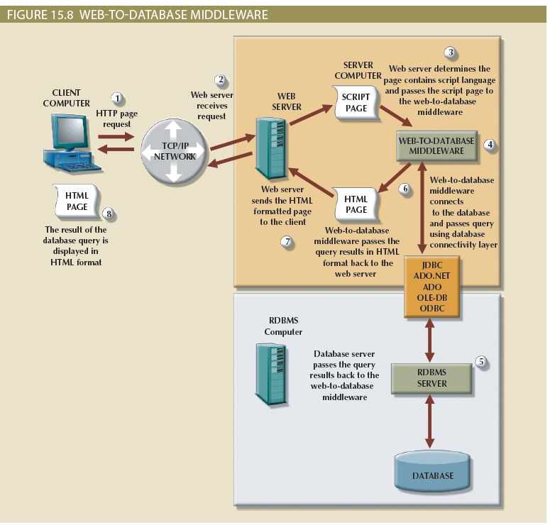
Copyright © 2017 Cengage Learning
7

Slide 8
Web Browser
Software that lets users navigate the web from their client computer
Interprets HTML code received from web server
Presents different page components in standard way
Web is a stateless system
Stateless system: Web server does not know the status of any clients
Copyright © 2017 Cengage Learning
8

Slide 9
Client-Side Extensions
Add functionality to Web browser
Types
Plug-in: External application automatically invoked by the browser when needed
Java and JavaScript: Embedded in web page
Downloaded with the Web page and activated by an event
ActiveX and VBScript: Embedded in web page
Downloaded with page and activated by event
Oriented to Windows applications
Copyright © 2017 Cengage Learning
9

Slide 10
Web Application Servers
Middleware application that expands the functionality of web servers by linking them to a wide range of services
Uses
Connect to and query database from web page
Create dynamic web search pages
Enforce referential integrity
Copyright © 2017 Cengage Learning
10

Slide 11
Features of Web Application Servers
Security and user authentication
Access to multiple services
Integrated development environment
Computational languages
Automation generation of HTML pages
Performance and fault - tolerant features
Database access with transaction management capabilities
Copyright © 2017 Cengage Learning
11

Slide 12
Web Database Development
Process of interfacing databases with the web browser
Code examples
ColdFusion
PHP
Copyright © 2017 Cengage Learning
12

Slide 13
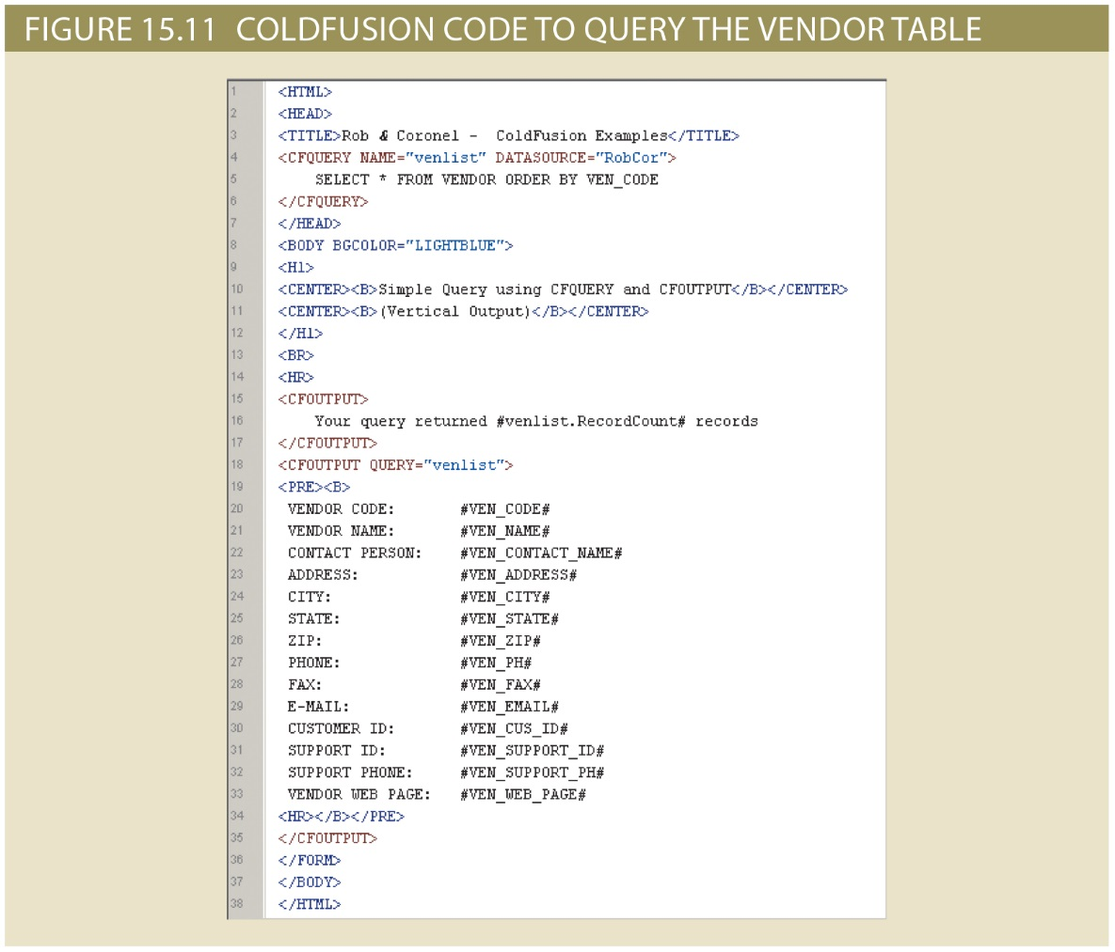
Copyright © 2017 Cengage Learning
13

Slide 14
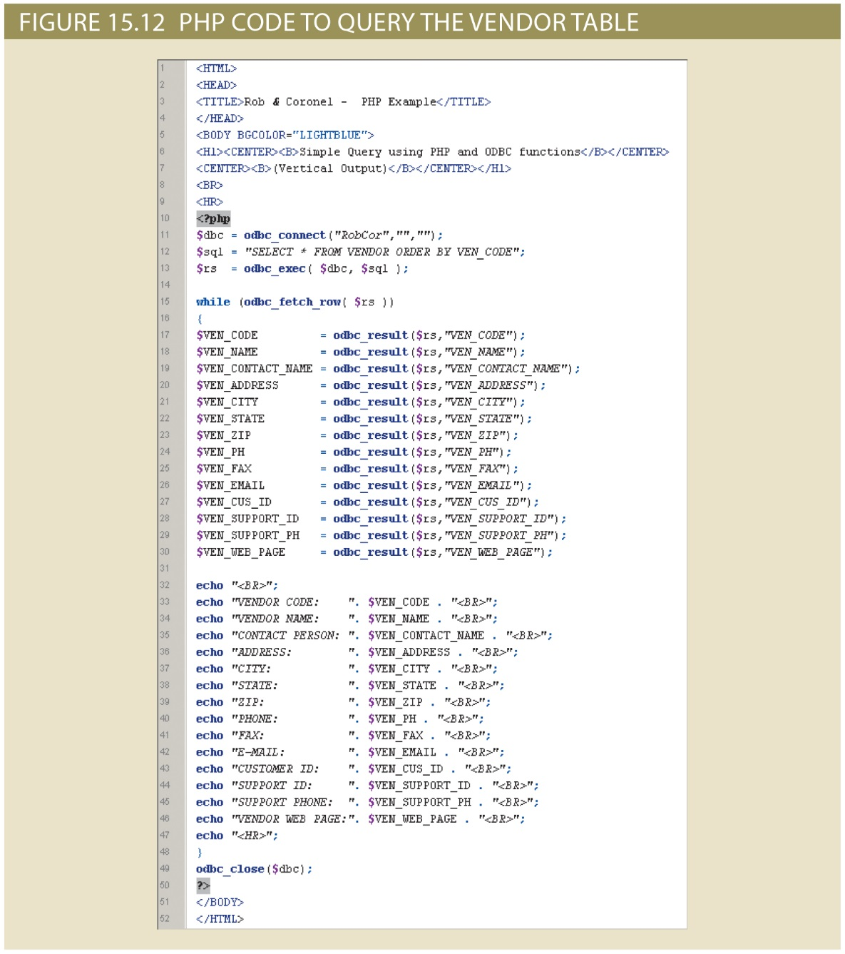
Copyright © 2017 Cengage Learning
14

Slide 15
Summary
Java Database Connectivity (JDBC) interfaces with Java applications with data sources
Database access through the Web uses middleware
On client side of Web browser, use plug-ins, Java and JavaScript, ActiveX, and VBScript
On server side, middleware expands functionality of Web servers
Links them to wide range of services
Copyright © 2017 Cengage Learning
15

Slide 16
Task
Go to the Amazon Web Services website and observe the variety of capabilities they provide.
Copyright © 2017 Cengage Learning
16

